Slide 1
FERTILITY RATES (1960-2013)
Yasmin Zahid

Slide 2
Introduction
The dataset under consideration provides a comprehensive overview of fertility rates across various countries spanning from 1960 to 2013. The fertility rate, typically measured as the number of births per woman, is a critical demographic indicator that reflects a country's reproductive behavior and has far-reaching implications for its economic, social, and health policies.

Slide 3
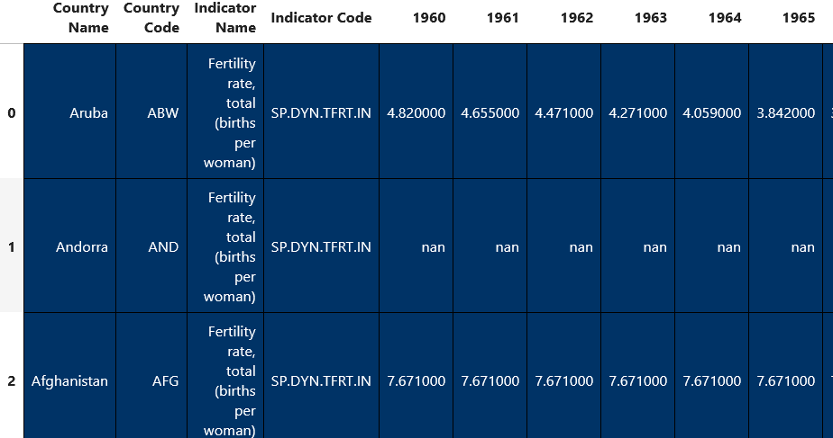
Dataset
The dataset is structured to provide yearly fertility rates for 215 countries, allowing for both cross-sectional and longitudinal analysis. Each entry in the dataset typically includes:
Country Name: The name of the country for which the data is recorded.
Year: The specific year from 1960 to 2013.
Fertility Rate: The average number of children a woman is expected to have during her lifetime.
Columns
Rows
Checking and deleting columns that are not needed, for example, Country Code, Indicator Name, and Indicator Code
Deleting rows with more than 40 missing values, as that is more than half their data missing.

Slide 4
Overview
These questions can provide insights into the birth rate distribution over time for a specific country or region and a global pattern can be explored.
Which country has the highest fertility rate for each year? Explain the findings.
2. Which country has the lowest fertility rate for each year? Explain the findings.
3. What countries had the highest and lowest difference in their birth rates from 1960 and 2013?
4. Show what the global trend was for fertility rates from 1960 to 2013?
5. Compare the birth rates changes in a developed region, like the United Kingdom with a developing country, such as Guinea.
6. Compare the birth rate changes in two regions, such as the Middle East and Central Europe.
7. Compare the two most populated countries, India and China.

Slide 5
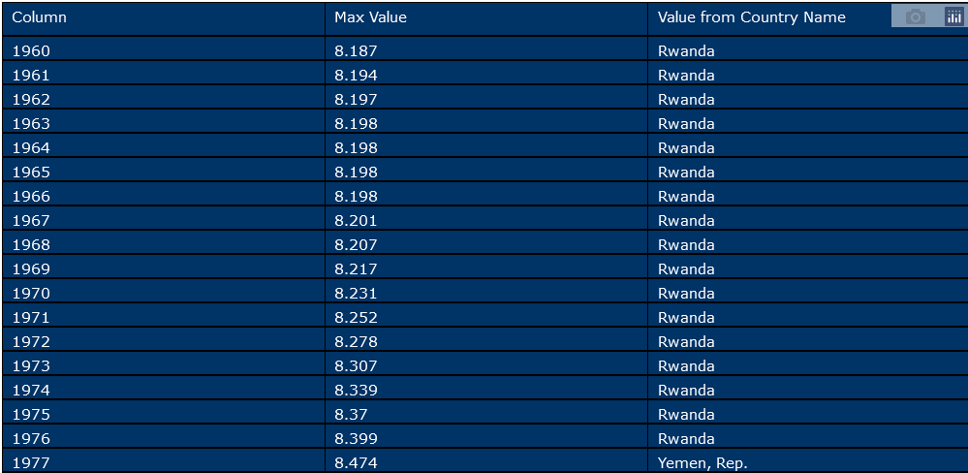
Which country has the highest fertility rate for each year? Explain the findings.
Notes:
The data reveals a significant shift in the country with the highest birth rate over the decades. Initially, Rwanda held the top position from 1960 to 1976, with birth rates steadily increasing, peaking at 8.399 births per woman in 1976. This high birth rate during Rwanda's early years reflects its demographic trends, characterized by high fertility rates typical of many developing nations during that period. From 1977 to 1994, Yemen, Rep. (now Yemen) took over as the country with the highest birth rate. The birth rate in Yemen surged to an impressive 9.223 births per woman by 1983, indicating a period of rapid population growth. A significant reason for Yemen's high birth rate during the late 20th century was strong cultural and societal values favoring large families. Economic factors also played a role, as children were seen as contributors to the family's economic stability. The mid-1990s mark a notable transition as Afghanistan briefly surpassed Yemen in 1995-1999. During this time, Afghanistan's birth rates remained high but were slightly lower than Yemen's peak rates. The high birth rates in Afghanistan reflect the country's socio-economic challenges and limited healthcare infrastructure. From 2000 onwards, Niger emerged as the country with the highest birth rate, a position it has maintained through to 2013. Niger’s birth rate remained remarkably high, reaching a peak of 7.617 births per woman in 2005. This sustained high birth rate highlights the continuing demographic pressures and the country’s struggle with high fertility rates despite various efforts to improve access to family planning and healthcare.

Slide 6
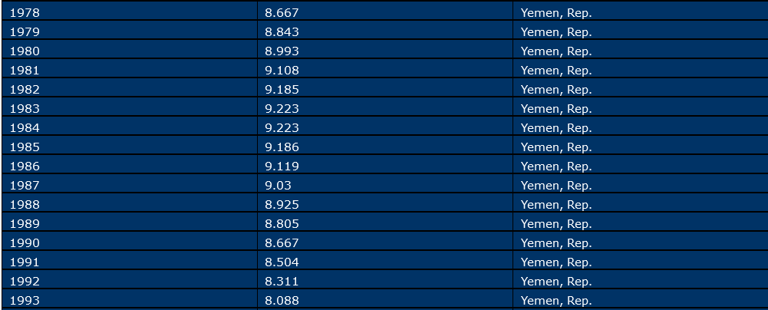

Slide 7
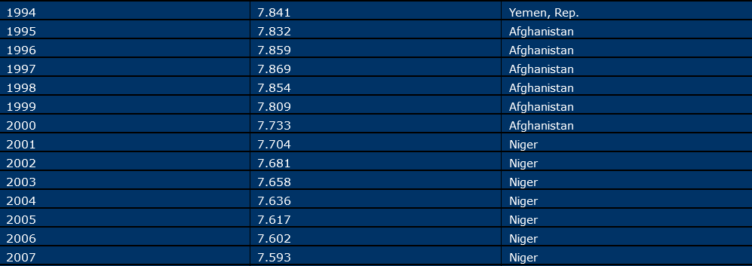


Slide 8
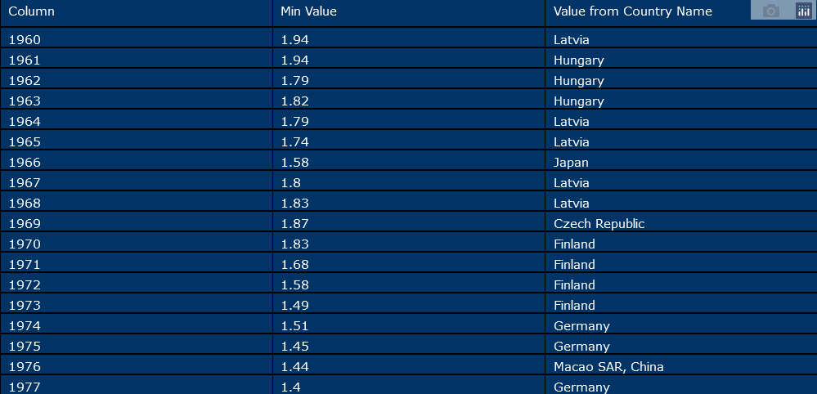
Which country has the lowest fertility rate for each year? Explain the findings.
Notes:
The data reveals notable trends in the countries with the lowest birth rates from 1960 to 2013. Initially, countries like Latvia and Hungary had the lowest birth rates in the 1960s, reflecting the early stages of demographic transition in Eastern Europe. Latvia's birth rate fluctuated between 1.940 and 1.740, while Hungary's rate decreased from 1.940 in 1961 to 1.790 in 1962, indicating a period of demographic shifts.
As we moved into the 1970s through to 1990s, Finland, Germany and Hong Kong became prominent for their low birth rates. Finland experienced a decline from 1.830 in 1970 to 1.490 in 1973, reflecting the impact of socio-economic changes and advancements in family planning. Germany's birth rate consistently remained low, with significant declines, reaching 1.290 by 1984. This pattern was indicative of Western Europe's broader trend of low fertility rates during this period.
By the late 1990s and early 2000s, Hong Kong, and Macao, emerged as regions with the lowest birth rates globally. Hong Kong birth rate dropped to 0.982 in 1999, and Macao rate fell below 1.000 from 2000 onward till 2009, reaching a low of 0.836 in 2004. This dramatic decline in Macao birth rate reflects the region's rapid economic growth, urbanization, and effective family planning policies, which are common in many highly developed areas.

Slide 9
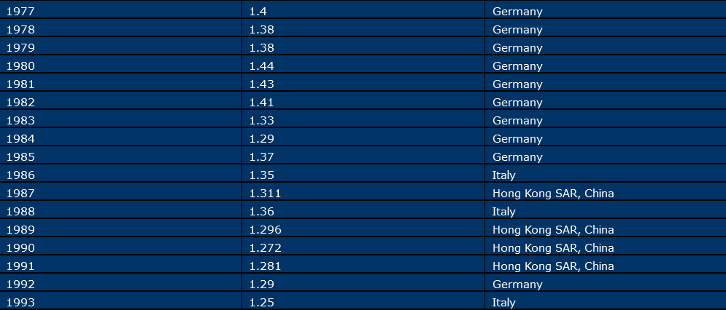

Slide 10
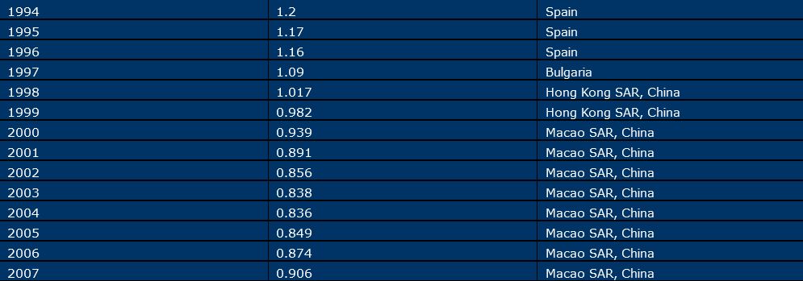


Slide 11
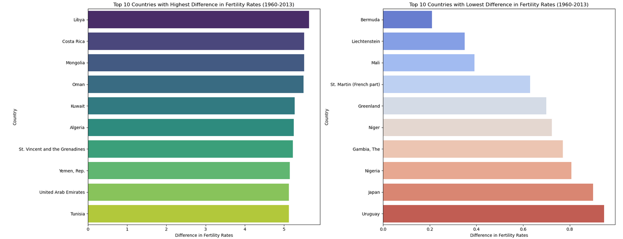
What countries had the highest and lowest difference in their birth rates from 1960 and 2013?
Notes:
The first chart shows that Libya, Costa Rica, and Mongolia experienced the highest reductions in fertility rates between 1960 and 2013, with decreases of around 5.5, 5.3, and 5.2 births per woman, respectively, reflecting significant socio-economic transformations.
The second chart indicates that Bermuda, Liechtenstein, and Mali had the lowest differences in fertility rates, with changes of approximately 0.2, 0.3, and 0.3 births per woman, suggesting relatively stable fertility rates over this period.

Slide 12
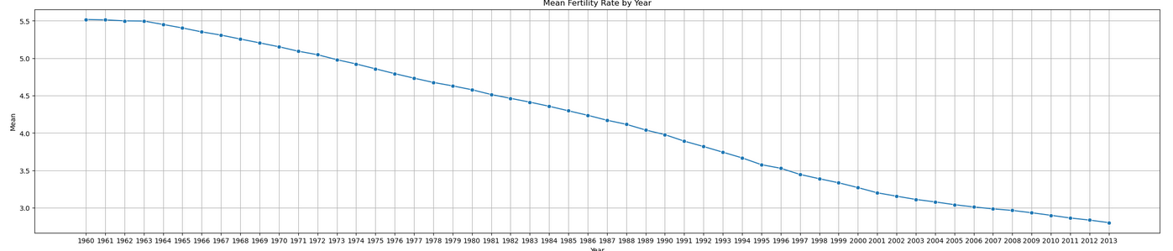
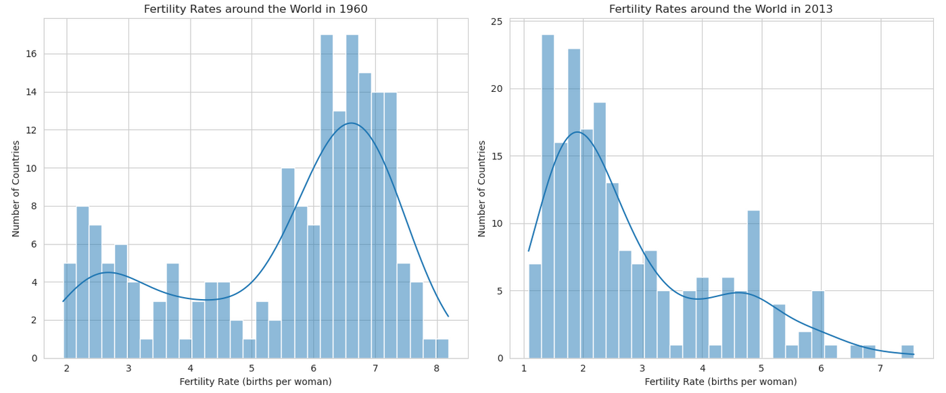
Show what the global trend was for fertility rates from 1960 to 2013?
Notes:
The graph clearly illustrates the global trend in fertility rates from 1960 to 2013, demonstrating a significant and consistent decline over this period. Here are the key points:
High Fertility Rates in the Early 1960s:
The graph starts with high fertility rates around 5.5 children per woman. This high rate is indicative of a time when many countries had limited access to family planning and higher desired family sizes.
Steady Decline Over the Decades:
From the 1960s to the mid-1970s, the fertility rate shows a gradual decline. This period marks the beginning of increased awareness and use of contraceptives and family planning programs.
Accelerated Decline in the Late 20th Century:
From the late 1970s to the early 1990s, the rate of decline accelerates. Factors such as improved healthcare, women's education, and economic development contribute to this trend. Countries across various regions implemented policies to control population growth, further aiding the decline.
Continued Decline into the 21st Century:
The decline continues steadily through the 1990s and into the 21st century, reaching below 3 children per woman by 2013. Advances in reproductive health services, socio-economic development, and shifts in societal norms regarding family size are critical factors.
Regional Variations:
While the global trend shows a decline, regional variations exist, with some countries experiencing slower declines due to cultural, economic, and infrastructural factors.
Here are the key conclusions we can draw about the trends:
Decrease in Fertility Rates:
In 1960, the majority of countries had high fertility rates, with a peak of around 6-7 births per woman. By 2013, fertility rates had significantly decreased. Most countries had fertility rates between 1 and 3 births per woman, with a peak of around 2 births per woman.
Shift in Distribution:
The 1960 distribution shows a more varied range of fertility rates, with a significant number of countries having very high rates (6-8 births per woman). In 2013, the distribution was more concentrated around lower fertility rates, indicating a global trend towards smaller family sizes.
Reduction in High Fertility Rates:
The number of countries with very high fertility rates (above 5 births per woman) has drastically reduced by 2013. There are very few countries with fertility rates above 5 in 2013 compared to 1960.
Increase in Low Fertility Rates:
In 1960, almost no countries had fertility rates below 2 births per woman. By 2013, many countries had fertility rates between 1 and 2 births per woman, indicating a trend towards lower fertility rates globally.

Slide 13
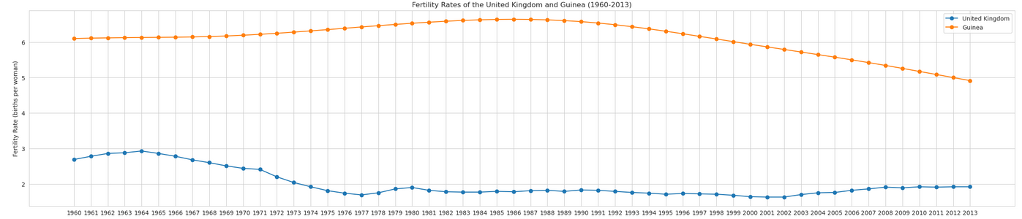
Compare the birth rates changes in a developed region, like the United Kingdom with a developing country, such as Guinea.
Notes:
United Kingdom:
1960s:
The fertility rate in the UK was relatively high, averaging around 2.5 to 3.0 children per woman, peaking in 1964.
1970s-1980s:
There was a notable decline in fertility rates during this period. By the mid-70s, the fertility rate had dropped to below 2.0 children per woman but there was a marginal gain after 1977 through the 1980. However, the rate initially fell then stabilized in the 80s.
1990s:
The decline continued, with fertility rates falling to around 1.6 to 1.7 children per woman by the late 1990s.
2000s-2013:
Fertility rates in the UK stabilized somewhat, hovering around 1.8 to 1.9 children per woman in the early 2000s. There were slight fluctuations, but the general trend was a stable low fertility rate.
Guinea:
1960s:
Guinea had a much higher fertility rate compared to developed nations. The fertility rate was around 6.0 to 6.5 children per woman.
1970s-1980s:
The fertility rate remained high and there were slight inclines. By the late 1980s, it was still around 6.5 to 7 children per woman, peaking by the mid-80s.
1990s:
There was a gradual decrease in fertility rates during this decade, falling to about 6.5 to 6.0 children per woman by the end of the 1990s.
2000s-2013:
The decline continued, with fertility rates decreasing to approximately 5.0 to 5.5 children per woman by 2013.
Comparison:
Land: The UK and Guinea have similar land areas, with Guinea being marginally larger.
Trend: The UK saw a steady decline in fertility rates, reflecting a mature demographic transition. Guinea experienced high, though declining, fertility rates, indicative of ongoing developmental changes.
Socioeconomic Factors: Lower fertility in the UK correlates with higher education and economic development; higher fertility in Guinea is linked to lower education and development levels.
Population Growth: The UK had moderate population growth, influenced by low fertility and immigration. Guinea faced high population growth due to higher fertility rates, though the growth rate was slowing. The UK’s population is significantly larger than Guinea’s, leading to higher population density in the UK.

Slide 14
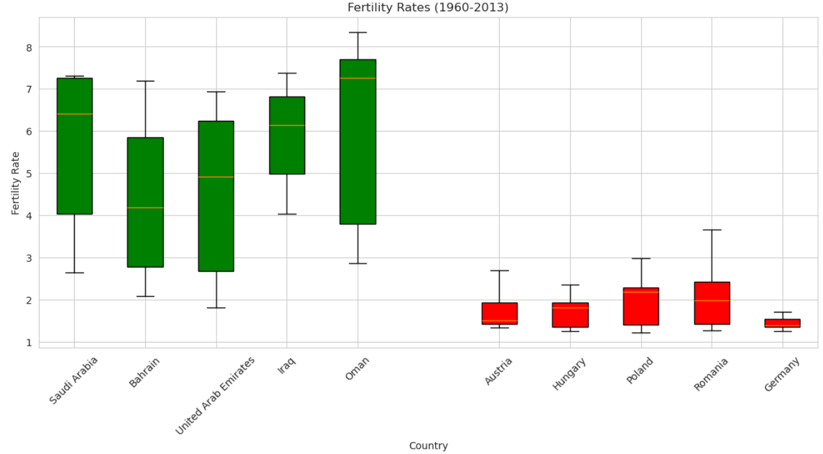
Compare the birth rate changes in two regions, such as the Middle East and Central Europe.
Notes:
Middle East Region
The fertility rates in the Middle East region, encompassing Saudi Arabia, Bahrain, United Arab Emirates, Iraq, and Oman, exhibit a broad range and substantial variability over the years from 1960 to 2013. The median fertility rates are relatively high, often exceeding 5 children per woman, with some countries like Saudi Arabia and Oman showing medians close to or above 7. The interquartile ranges (IQRs) are wide, indicating significant fluctuations in fertility rates across different periods. The presence of long whiskers extending to lower values, particularly in Bahrain and United Arab Emirates, suggests periods of notable declines in fertility. The cultural significance of larger families in many Middle Eastern societies has played a crucial role in sustaining higher fertility rates. In these cultures, having more children is often associated with social status, economic support in old age, and fulfilling traditional roles, which reinforces the tendency towards larger family sizes.
Central European Region
This region, represented by Austria, Hungary, Poland, Romania and Germany shows considerably lower and more stable fertility rates over the same period. The median fertility rates are around or below 2 children per woman, reflecting a trend towards smaller family sizes. The interquartile ranges are narrower compared to the Middle East, indicating less variability and more consistent fertility patterns over time. The box plots reveal a generally lower spread and fewer extreme values. suggesting that fertility rates in Central Europe have been influenced by different socio-economic conditions, such as higher levels of urbanization, greater access to education and healthcare, and different cultural attitudes towards family size and childbearing. These factors have contributed to a more gradual and steady trend in fertility rates across the region.

Slide 15
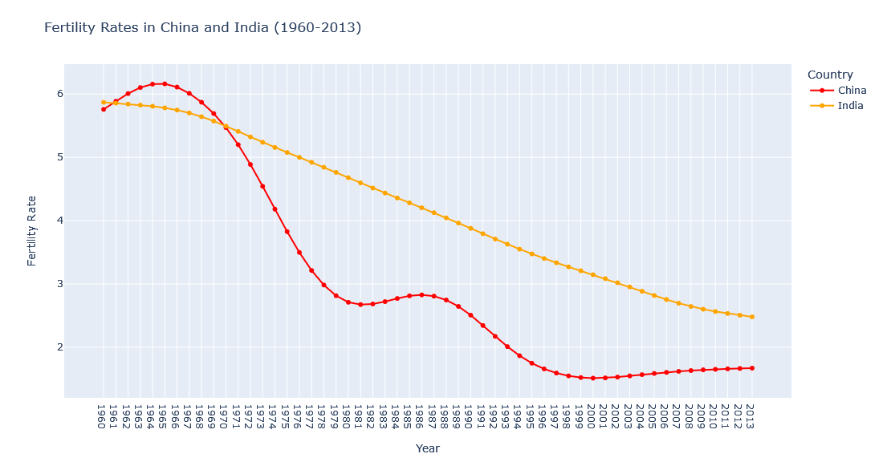
Compare the two most populated countries, India and China.
Notes:
Over the past several decades, from 1960 to 2013, the fertility rates in China and India have exhibited distinct patterns reflective of their unique socio-economic and policy environments. In China, the fertility rate has shown a dramatic decline, particularly due to the One-Child Policy introduced in 1979. This policy aimed to control the rapidly growing population by restricting most urban couples to having only one child, with some exceptions for rural families and ethnic minorities. The policy significantly reduced birth rates, resulting in one of the lowest fertility rates in the world by the early 21st century. However, it also led to long-term demographic challenges, such as a skewed gender ratio and an aging population. In contrast, India’s fertility rate, while also declining, has done so at a more gradual pace throughout this period. India’s approach to population control has been less restrictive, focusing on voluntary family planning and education rather than enforcement. As a result, India’s fertility rate remains higher than China’s but has been steadily decreasing due to improved healthcare and increased awareness.

Slide 16
Conclusion

Slide 17
Thank you
Yasmin Zahid
https://www.linkedin.com/in/yasmin-zahid-9208bb9b/
https://github.com/Yasmin-Zahid/Data-Analysis-Portfolio

